Slide 1
SE Activities
Analysis
Design
Implementation
C
o
m
m
u
n
i
c
a
t
i
o
n
p
r
o
j
e
c
t
i
n
i
t
i
a
t
i
o
n
Planning
r
e
q
u
i
r
e
m
e
M
o
d
e
l
i
n
g
n
t
g
a
t
h
e
r
i
n
g
estimating
scheduling
a
n
a
l
y
s
i
s
C
o
n
s
t
r
u
c
t
i
o
n
tracking
d
e
s
i
g
n
c
o
d
e
D
e
p
l
o
y
m
e
n
t
t
e
s
t
d
e
l
i
v
e
r
y
s
u
p
p
o
r
t
f
e
e
d
b
a
c
k
Each phase has three components:
Set of activities - This is what you do
Set of deliverables - This is what you produce.
Quality Control Measures - This is what you use to evaluate the deliverables.
CS585
<number>/

Slide 2
Introduction
OO
CS585

Slide 3
Objects
Are entities in a computer program that have three characteristics
  State (determined by the data fields or attributes)
  Behavior (determined by the methods or operations of the object)
  Identity (2 students objects, each has its own identity)
Voice Mail box object states
  Empty
  Full
  These states impact the object response to certain events.
    When Full play a message indicating so …
Bounded Buffer as an implementation of the voice mail box object
CS585
<number>/

Slide 4
Object-oriented Programming (OOP)
Class vs. Object
Support OO concepts
  Inheritance
  Polymorphism
  Encapsulation
  Abstraction
Reusable components
Etc.
CS585
<number>/

Slide 5
Classes and Objects Examples
Date class
  data: month, day, year
  operations to set and return month, day, year
  a Date object
    June
    23
    2004
Student class
  Data: name, year, and grade point average
  Methods: store/get the value of each piece of data, promote to next year, etc.
  Student Object: student1
    Data: Maria Gonzales, Sophomore, 3.5
CS585
<number>/

Slide 6
Classes and Objects
An object:
  Point point1 = new Point();
Attributes or fields:
int x, y;
A method:
void move(int dx, int dy)
A message:
point1.move(10, 10)
Class Point {
int x, y;
public void move (int dx, int dy) {
x +=dx;
y +=dy;
}
}
CS585
<number>/

Slide 7
OOP Advantage: Reuse
Well-written classes can be reused in new applications
Shortens development time because programmers don't need to write new code
Programs are more robust because the class code is already tested
CS585
<number>/

Slide 8
An Object of class Time
OPERATIONS DATA
Set
Private data:
hrs 8
mins 25
secs 42
Increment
Write
.
.
.
Time
CS585
<number>/

Slide 9
OO Design
OO Concepts
CS585

Slide 10
Two Design Strategies
FUNCTIONAL OBJECT-ORIENTED
DECOMPOSITION DESIGN
FUNCTION
OBJECT
FUNCTION
.
.
.
OBJECT
OBJECT
FUNCTION
.
.
.
.
.
.
CS585
<number>/

Slide 11
Object-Oriented Programming
Classes combine data and the methods (code) to manipulate the data
Classes are a template used to create specific objects
All Java programs consist of at least one class.
CS585
<number>/

Slide 12
Some Terminology
Object reference: identifier of the object
Instantiating an object: creating an object of a class
Instance of the class: the object
Methods: the code to manipulate the object data
Calling a method: invoking a service for an object.
CS585
<number>/

Slide 13
Class Data
Instance variables: variables defined in the class and given values in the object
Fields: instance variables and static variables (we'll define static later)
Members of a class: the class's fields and methods
Fields can be:
  any primitive data type (int, double, etc.)
  objects
CS585
<number>/

Slide 14
Encapsulation
Implementation of a module should be separated from its users.
Instance variables are usually declared to be private, which means users of the class must reference the data of an object by calling methods of the class.
Thus the methods provide a protective shell around the data. We call this encapsulation.
Benefit: the class methods can ensure that the object data is always valid.
CS585
<number>/

Slide 15
Modularity
Divide-and-conquer
Decompose a complex system into a highly cohesive loosely coupled modules.
  Cohesion single-mind-ness of a module
    Each module should small and simple
  Coupling the degree of connectivity between modules
    Interactions between modules should be simple
CS585
<number>/

Slide 16
Abstraction
Separating the essential from the nonessential
The behaviors of a module should be characterized in a precise way using its interfaces.
Server provider for example is a client that provide services (methods) to it’s clients.
  Clients need to know only the contract API.
Abstraction
  Denotes the essential characteristics of an object that distinguishes it from all kinds of objects.
    What does the object do without any implication on how does it do it
  A software object is an abstraction
    A representation of something in the real word like a student, a book, …
CS585
<number>/

Slide 17
Principals of OO - Encapsulation
Encapsulation
  The process of Compartmentalizing the elements of an object that constitute its structure and behavior
    Data hiding
    Localize design decisions
  What are the encapsulated elements?
    Information that describes the object (the things an object know about itself)
      No of pages, cover type, ISBN, and other Book information
      State, the object’s current condition (or state)
    Behavior
      What the object can do (register, drop etc.)
      What can be done to it (a pencil object can Write!!)
Encapsulation
CS585
<number>/

Slide 18
Polymorphism
Polymorphism - Many shapes
  The same operation may behave differently on different classes.
    Example + sign
    Same method many ways to call it (dynamic)
  Overloading of operations
    Same operation with different signatures
  When an object is substituted with one of its children at run time
    (The is-a relationship)
CS585
<number>/

Slide 19
Reusability
Reuse: class code is already written and tested, so you build a new application faster and it is more reliable
Example: A Date class could be used in a calendar program, appointment-scheduling program, online shopping program, etc.
CS585
<number>/

Slide 20
How To Reuse A Class
You don't need to know how the class is written.
You do need to know the application programming interface (API) of the class.
The API is published and tells you:
  How to create objects
  What methods are available
  How to call the methods
CS585
<number>/

Slide 21
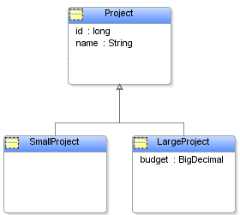
Inheritance
Wiki
“In object-oriented programming, inheritance is a way to form new classes (instances of which are called objects) using classes that have already been defined. The inheritance concept was invented in 1967 for Simula.
The new classes, known as derived classes, take over (or inherit) attributes and behavior of the pre-existing classes, which are referred to as base classes (or ancestor classes). It is intended to help reuse existing code with little or no modification.
“
CS585
<number>/

Slide 22
Object Behavior - Object Life Cycle
Initialize
Object
Wait for
Request
Handle
Request
Terminate
Object
CS585
<number>/

Slide 23
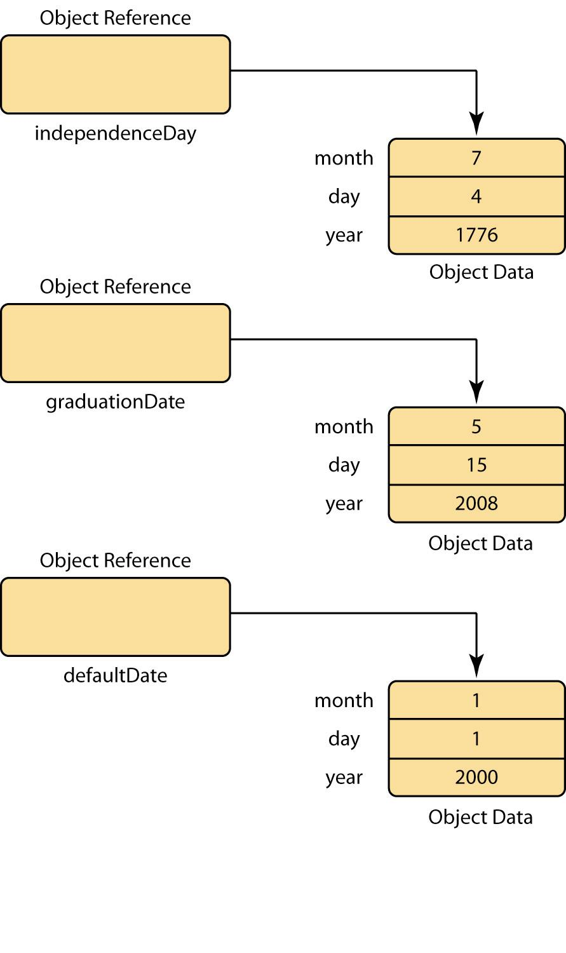
Objects After Instantiation

Slide 24
Notes
Public methods of a class denote services objects of the class can perform
Only primitive types in Java store their value, all other types the variable stores a reference to the data
int x =55;
55
“OMAR”
String name;

Slide 25
Object Reference vs. Object Data
Object references point to the location of object data.
An object can have multiple object references pointing to it.
  Or an object can have no object references pointing to it.
  If so, the garbage collector will free the object's memory
See
  Example Next Slide

Slide 26
Example ObjectReferenceAssignment.java
public class ObjectReferenceAssignment {
public static void main( String [] args ) {
Date hireDate = new Date( 2, 15, 2003 );
System.out.println( "hireDate is " + hireDate.getMonth( ) + "/" +
hireDate.getDay( ) + "/" + hireDate.getYear( ) );
Date promotionDate = new Date( 9, 28, 2004 );
System.out.println( "promotionDate is " + promotionDate.getMonth( )
+ "/" + promotionDate.getDay( ) + "/" + promotionDate.getYear( ) );
promotionDate = hireDate; ⬅
System.out.println( "\nAfter assigning hireDate “ + "to promotionDate:" );
System.out.println( "hireDate is " + hireDate.getMonth( )
+ "/" + hireDate.getDay( ) + "/" + hireDate.getYear( ) );
System.out.println( "promotionDate is " + promotionDate.getMonth( ) + "/" +
promotionDate.getDay( ) + "/" + promotionDate.getYear( ) );
}
}

Slide 27
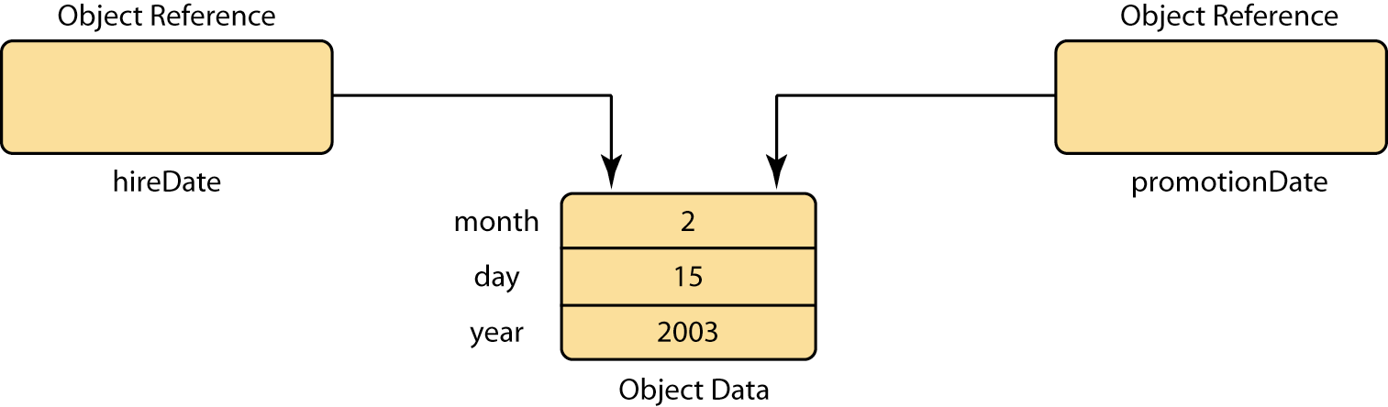
Two References to an Object
After the example runs, two object references point to the same object

Slide 28
null Object References
An object reference can point to no object. In that case, the object reference has the value null
Object references have the value null when they have been declared, but have not been used to instantiate an object.
Attempting to use a null object reference causes a NullPointerException at run time.

Slide 29
Example NullReference.java
public class NullReference
{
public static void main( String[] args )
{
Date aDate;
aDate.setMonth( 5 );
}
}

Slide 30
static Methods
Also called class methods
Can be called without instantiating an object
Might provide some quick, one-time functionality,
  for example, popping up a dialog box
  Math.abs(-9);
Stateless Objects
In method API, keyword static precedes return type
static dataType mthodName (arg1,ard2,…);

Slide 31
Calling static Methods
Use dot syntax with class name instead of object reference
Syntax:
ClassName.methodName( args )
Example:
int absValue = Math.abs( -9 );
Uses of class methods
  Provide access to class variables without using an object

Slide 32
static Class Variables
Class variables are variables that are stored among all objects of a given class
  Defining constants
    public final static c=299792458
  Allow all objects of a class to share a piece of data
    How many objects have been created
Syntax:
ClassName.staticVariable
Example:
  Color.BLUE
  BLUE is a static constant of the Color class.

Slide 33
Static Class Variables and Static Methods
class Counter {
private int value;
private static int numCounters = 0; ⬅
public Counter() {
value = 0;
numCounters++;
}
public static int getNumCounters() { ⬅
return numCounters; }
}
...
System.out.println("Number of counters: "
+ Counter.getNumCounters()); ⬅

Slide 34
Static vs. Instance Variable
Class (static)
  the class has one copy for all instances
  Can use class variables In instance methods and in class methods
instance variables
  each instance has its own copy
  Can use instance variables in instance methods only

